Slide 1


Data Structures
Lecture 2
Complexity Analysis
Subhan Ullah, PhD
subhan.ullah@nu.edu.pk
BS(Cybersecurity) Fall-2023

Slide 2
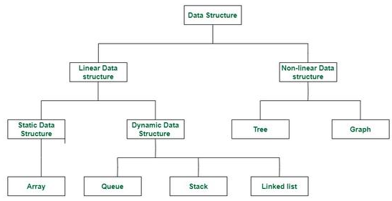
Classification data structures
https://www.geeksforgeeks.org/data-structures/?ref=shm_outind

Slide 3
Comparing Algorithms
Given two or more algorithms to solve the same problem, how do we select the best one?
Some criteria for selecting an algorithm
Is it easy to implement, understand, modify?
How long does it take to run it to completion?
How much of computer memory does it use?
Software engineering is primarily concerned with the first criteria
In this course we are interested in the second and third criteria

Slide 4
Comparing Algorithms
Time complexity
The amount of time that an algorithm needs to run to completion
Better algorithm is the one which runs faster
Has smaller time complexity
Space complexity
The amount of memory an algorithm needs to run
In this lecture, we will focus on analysis of time complexity

Slide 5
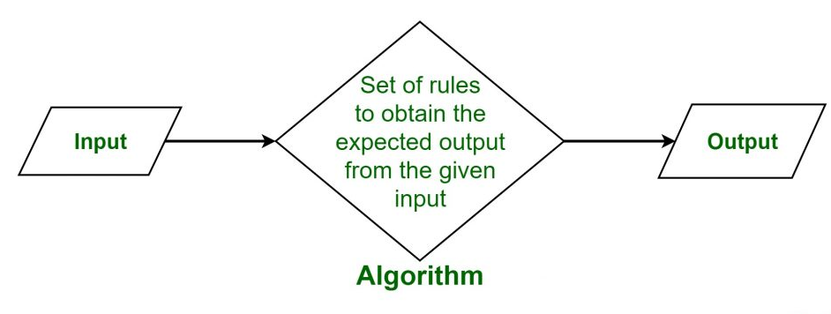
What is algorithm?
https://www.geeksforgeeks.org/data-structures/?ref=shm_outind

Slide 6
How To Calculate Running Time
Most algorithms transform input objects into output objects
The running time of an algorithm typically grows with input size
Idea: analyze running time as a function of input size
sorting
algorithm
5
3
1
2
1
2
3
5
input object
output object

Slide 7
How To Calculate Running Time
Most important factor affecting running time is usually the size of the input
Regardless of the size n of an array the time complexity will always be same
Every element in the array is checked one time
int find_max( int *array, int n ) {
int max = array[0];
for ( int i = 1; i < n; ++i ) {
if ( array[i] > max ) {
max = array[i];
}
}
return max;
}

Slide 8
How To Calculate Running Time
Even on inputs of the same size, running time can be very different
Idea: Analyze running time for different cases
Best case
Worst case
Average case
int search(int arr[], int n, int x) {
int i;
for (i = 0; i < n; i++)
if (arr[i] == x)
return i;
return -1;
}

Slide 9
How To Calculate Running Time
Best case running time is usually not very useful
Average case time is very useful but often hard to determine
Worst case running time is easier to analyze
Crucial for real-time applications such as games, finance and robotics

Slide 10
Experimental Evaluations of Running Times
Write a program implementing the algorithm
Run the program with inputs of varying size
Use clock methods to get an accurate measure of the actual running time
Plot the results

Slide 11
Limitations Of Experiments
Experimental evaluation of running time is very useful but
It is necessary to implement the algorithm, which may be difficult
Results may not be indicative of the running time on other inputs not included in the experiment
In order to compare two algorithms, the same hardware and software environments must be used

Slide 12
Theoretical Analysis of Running Time
Uses a pseudo-code description of the algorithm instead of an implementation
Characterizes running time as a function of the input size n
Takes into account all possible inputs
Allows us to evaluate the speed of an algorithm independent of the hardware/software environment

Slide 13
Analyzing an Algorithm – Operations
Each machine instruction is executed in a fixed number of cycles
We may assume each operation requires a fixed number of cycles
Idea: Use abstract machine that uses steps of time instead of secs
Each elementary operation takes 1 steps
Example of operations
Retrieving/storing variables from memory
Variable assignment =
Integer operations + - * / % ++ --
Logical operations && || !
Bitwise operations & | ^ ~
Relational operations == != < <= => >
Memory allocation and deallocation new delete

Slide 14
Analyzing an Algorithm
// Input: int A[N], array of N integers
// Output: Sum of all numbers in array A
int SumArray(int A[], int n){
int s=0;
for (int i=0; i< n; i++)
s = s + A[i];
return s;
}
1
2
3
4
5
6
7
8
Operations 1, 2, and 8 are executed once
Operations 4, 5, 6, and 7: Once per each iteration of for loop n iteration
Operation 3 is executed n+1 times
The complexity function of the algorithm is : T(n) = 5n +4

Slide 15
Analyzing an Algorithm – Growth Rate
Estimated running time for different values of n:
n = 10 => 54 steps
n = 100 => 504 steps
n = 1,000 => 5004 steps
n = 1,000,000 => 5,000,004 steps
As n grows, number of steps T(n) grow in linear proportion to n

Slide 16
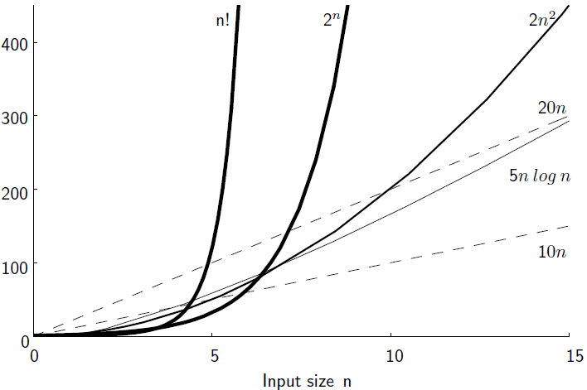
Growth Rate

Slide 17
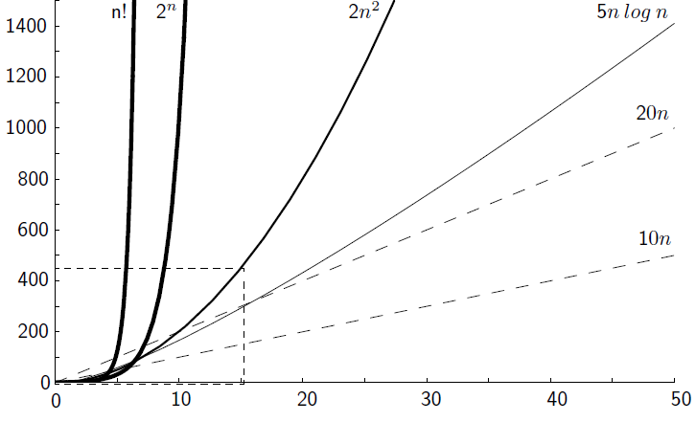
Growth Rate

Slide 18
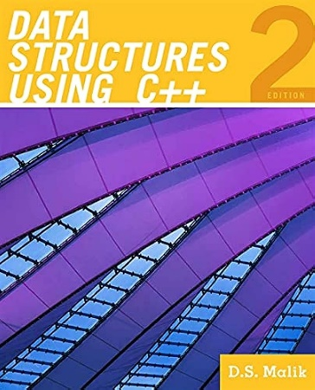
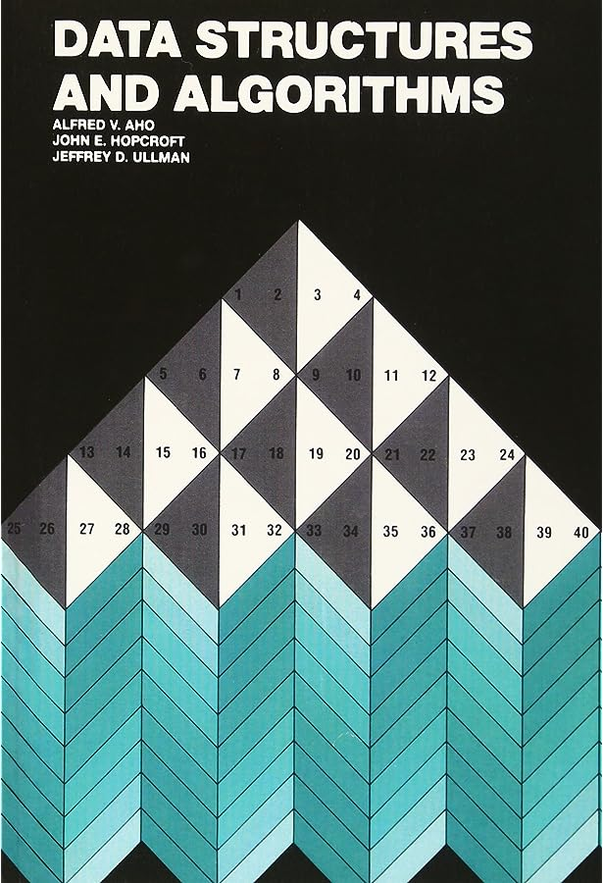
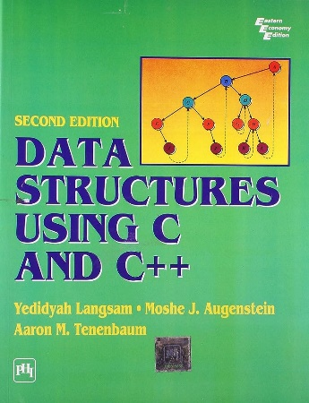
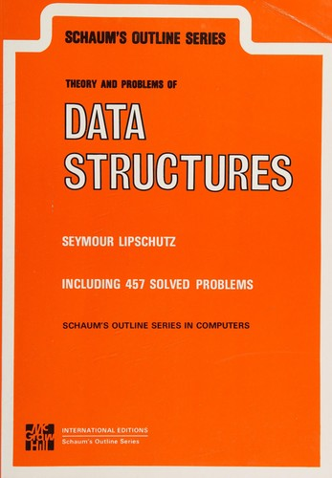
Thank You All
☺
?
A note on the origin of these ppt slides: Thanks to Dr. Zainab FAST-NUCES, ISB and Douglas Wilhelm Harder, M.Math. LEL Department of Electrical and Computer Engineering University of Waterloo Waterloo, Ontario, Canada, I have adopted my slides from their slides.

